Slide 1
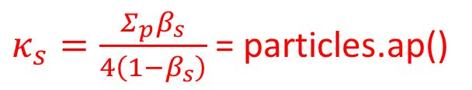

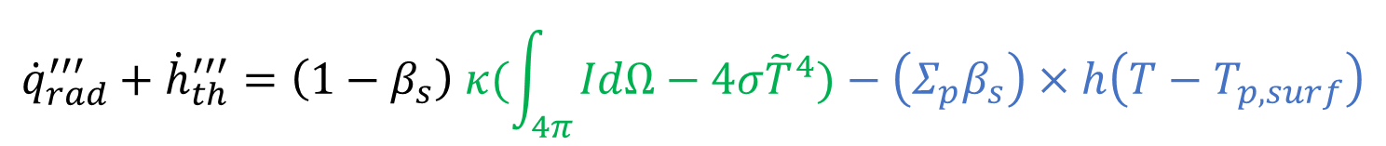
Radiation Transfer Equation
$$\frac{d}{ds}\left(\left(1−β_{s}\right)I\right)=−\left(κ_{g}+κ_{s}\right)\left(1−β_{s}\right)I+\left(1−β_{s}\right)\left(κ_{g}\frac{σ{\tilde{T}}^{4}}{π}+\frac{Σ_{p}β_{s}}{4(1−β_{s})}\frac{σT_{p,surf}^{4}}{π}\right)$$
$κ_{s}=\frac{Σ_{p}β_{s}}{4\left(1−β_{s}\right)}$ = particles.ap()
particles.Ep() (EDisp)
$${\dot{q}}_{rad}^{′′′}+{\dot{h}}_{th}^{′′′}=\left(1−β_{s}\right) κ(\int_{4π}{IdΩ}−4σ{\tilde{T}}^{4})−\left(Σ_{p}β_{s}\right)×h\left(T−T_{p,surf}\right)$$
radiation.Sh(thermo)
particles.Q_conv()
$Sh=a G−E−4a σ T^{4}$

Slide 2
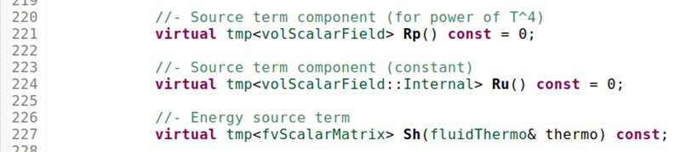
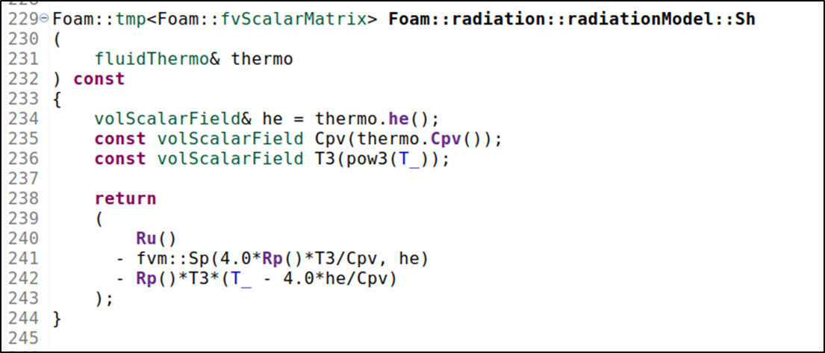

Source Term $radiation.Sh(thermo)$
radiationModel.H
Rp and Ru are used to calculate the radiation source term in the energy equation only
radiationModel.C
$$Sh≅ Ru − Rp T^{4}$$

Slide 3
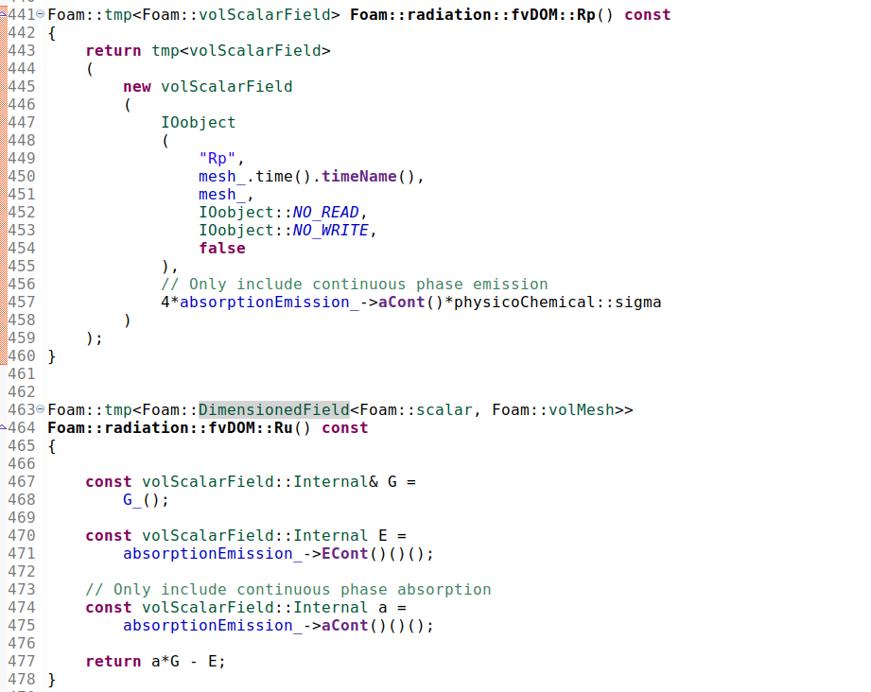
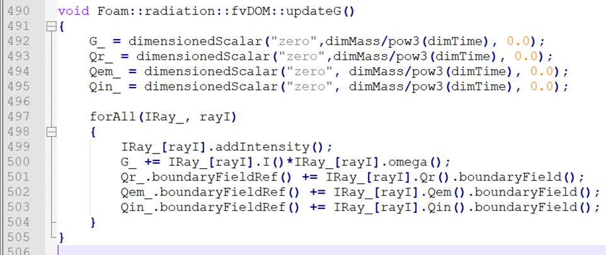


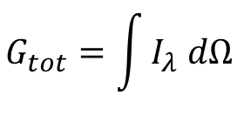



Source Term $radiation.Sh(thermo)$
FvDOM.C
$$Rp ≈4 a σ$$
$$G_{tot}=\int{I_{λ} dΩ}$$
Absorption coef. for continuous phase
$$Sh≅ Ru − Rp T^{4}$$
$=aCont G_{tot}−ECont−4 aCont σ T^{4}$
Emission contribution for continuous phase
$$aCont≅κ_{g}$$
$ECont≅χ_{rad}HRR$ when aCont=0
$$Ru ≈a G −E$$

Slide 4
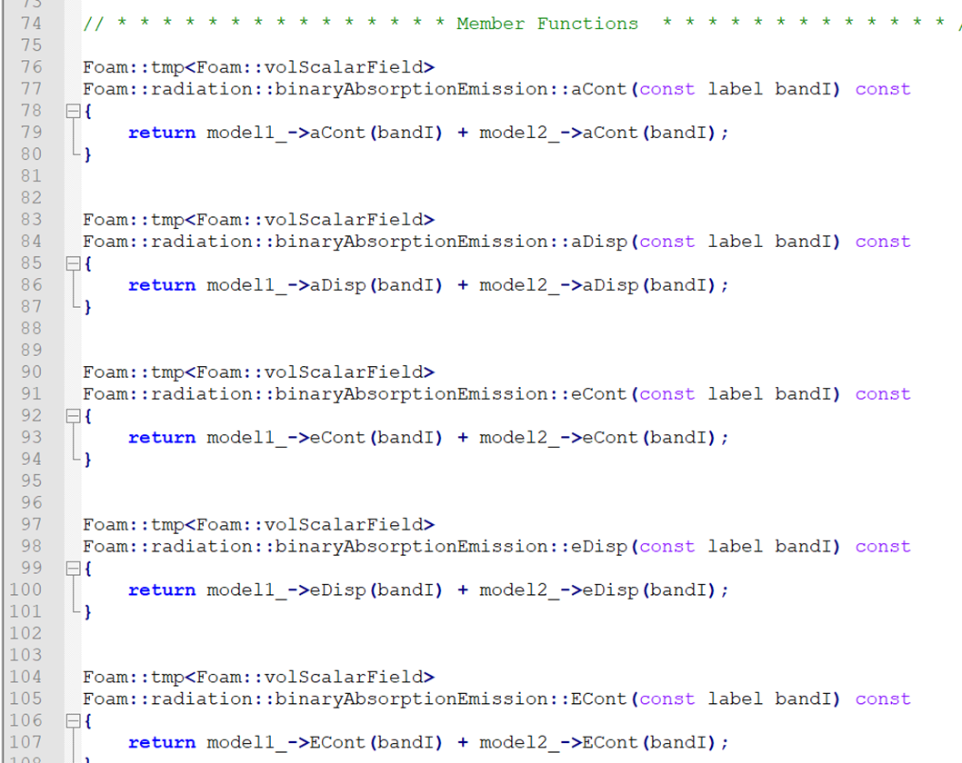
Binary absorption emission model:
Basically adds and returns the absorption and emission coefficients and terms from two distinct models
binaryAbsorptionEmission.C

Slide 5
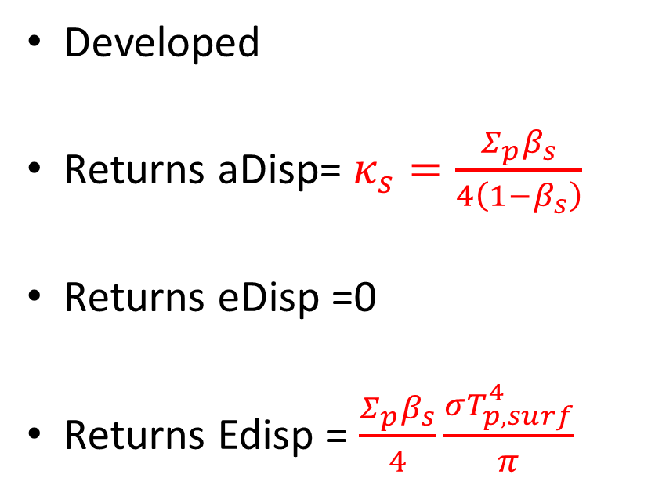
biomassCloudAbsorptionEmission
Developed
Returns aDisp= $κ_{s}=\frac{Σ_{p}β_{s}}{4\left(1−β_{s}\right)}$
Returns eDisp =0
Returns Edisp = $\frac{Σ_{p}β_{s}}{4}\frac{σT_{p,surf}^{4}}{π}$
To be used in the RTE Only!!

Slide 6
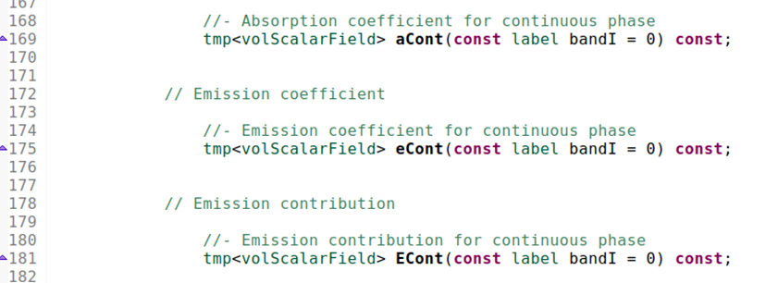
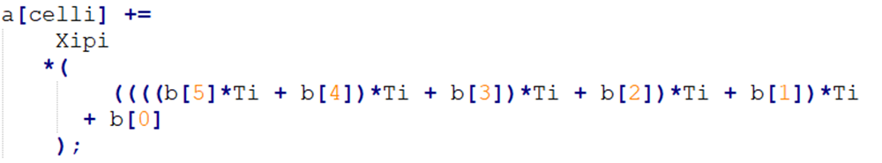
greyMeanAbsorptionEmission
$$aCont$$
$$eCont$$
$$ECont$$

